Slide 1
Code Generation
Lecture 20
Section 8.1 - 8.4
Rokan Uddin Faruqui
Associate Professor
Dept of Computer Science and Engineering University of Chittaong, Bangladesh Email: rokan@cu.ac.bd

Slide 2
Source Program
Phases of compilation
Scanner (Lexical analysis)
Token
Parser (Syntax analysis
Symbol Table
Frontend
Tree Semantic analysis
Tree
Intermediate code generation
IR
Machine-independent code optimization
IR
Target code generation
Backend
Target Code
Machine-specific code improvement (optional)
Target Code
Code Generation

Slide 3
The compiler Backend
Phases of compilation
What have we obtained by the front-end transformations?
Assuming we have produced relatively low-level IR (like 3-address code), we can assume that all syntactic and semantic errors have been eliminated.
Code Generation

Slide 4



Design Issues
Outline
1
Design Issues
2
Target Language
3
Basic Blocks and Flow Graphs
Code Generation

Slide 5
What code generation issues are important?
Design Issues
Correctness (preserving the semantics) of the program.
Speed of the target program (efficient use of the target machine’s resources)
Speed and structure of the code generator (length, easy to implement, test and maintain).
Code Generation

Slide 6
What code generation issues are important?
Design Issues
Correctness (preserving the semantics) of the program.
Speed of the target program (efficient use of the target machine’s resources)
Speed and structure of the code generator (length, easy to implement, test and maintain).
Code Generation

Slide 7
What code generation issues are important?
Design Issues
Correctness (preserving the semantics) of the program.
Speed of the target program (efficient use of the target machine’s resources)
Speed and structure of the code generator (length, easy to implement, test and maintain).
Code Generation

Slide 8
What code generation issues are important?
Design Issues
Hilbert’s 10th Problem
1936 — Alonzo Church — Computable Function Alan Turing —> Turing Machine
L = { a^nb^nc^n | n > 0 }
Generating an optimal target program for a given source program is undecidable. Many subprogroblems encountered in code generation are computationally intractable
there are heuristics to generate good code optimization on the IR helps
Code Generation

Slide 9
What code generation issues are important?
Design Issues
Generating an optimal target program for a given source program is undecidable. Many subprogroblems encountered in code generation are computationally intractable
there are heuristics to generate good code optimization on the IR helps
Code Generation

Slide 10


Code Generator: Input
Design Issues
1
Three-address presentations (quadruples, triples, . . . )
2
Virtual machine presentations (bytecode, stack-machine, . . . )
Text
Linear presentation (postfix, . . . )
Graphical presentation (syntax trees, DAGs, . . . )
3
4
Code Generation

Slide 11
Code Generator: Input
Design Issues
Three-address presentations (quadruples, triples, . . . )
Virtual machine presentations (bytecode, stack-machine, . . . ) Linear presentation (postfix, . . . )
Graphical presentation (syntax trees, DAGs, . . . )
1
2
3
4
Code Generation

Slide 12
Code Generator: Input
Design Issues
Three-address presentations (quadruples, triples, . . . )
Virtual machine presentations (bytecode, stack-machine, . . . ) Linear presentation (postfix, . . . )
Graphical presentation (syntax trees, DAGs, . . . )
1
2
3
4
Code Generation

Slide 13
Code Generator: Input
Design Issues
Three-address presentations (quadruples, triples, . . . )
Virtual machine presentations (bytecode, stack-machine, . . . ) Linear presentation (postfix, . . . )
Graphical presentation (syntax trees, DAGs, . . . )
1
2
3
4
Code Generation

Slide 14
Code Generator : Target Program
Design Issues
Instruction set architecture (RISC, CISC)
CISC MANY, SPECIALIZED instructions, FEW registers, variety of addressing-modes (CISC requires micro code)
RISC FEW, SIMPLE, ORTHOGONAL instructions, MANY registers, simple addressing-modes (RISK drives hardware directly)
Stack Machine Instruction set is organized with NO REGISTERS, all operations done on stack (e.g. ADD instuctions whence no arguments..)
1
Producing absolute machine-language program Producing relocatable machine-language program Producing assembly language programs
2
3
4
Code Generation

Slide 15
Code Generator : Target Program
Design Issues
Instruction set architecture (RISC, CISC)
CISC MANY, SPECIALIZED instructions, FEW registers,
1
variety of addressing-modes (CISC requires micro code)
RISC FEW, SIMPLE, ORTHOGONAL instructions, MANY registers, simple addressing-modes (RISK drives hardware directly)
Stack Machine Instruction set is organized with NO REGISTERS, all operations done on stack (e.g. ADD instuctions whence no arguments..)
2
Producing absolute machine-language program
Producing relocatable machine-language program Producing assembly language programs
3
4
Code Generation

Slide 16
Code Generator : Target Program
Design Issues
Instruction set architecture (RISC, CISC)
CISC MANY, SPECIALIZED instructions, FEW registers, variety of addressing-modes (CISC requires micro code)
RISC FEW, SIMPLE, ORTHOGONAL instructions, MANY registers, simple addressing-modes (RISK drives hardware directly)
Stack Machine Instruction set is organized with NO REGISTERS, all operations done on stack (e.g. ADD instuctions whence no arguments..)
1
2
Producing absolute machine-language program
Producing relocatable machine-language program Producing assembly language programs
3
4
Code Generation

Slide 17
Code Generator : Target Program
Design Issues
Instruction set architecture (RISC, CISC)
CISC MANY, SPECIALIZED instructions, FEW registers, variety of addressing-modes (CISC requires micro code)
RISC FEW, SIMPLE, ORTHOGONAL instructions, MANY registers, simple addressing-modes (RISK drives hardware directly)
Stack Machine Instruction set is organized with NO REGISTERS, all operations done on stack (e.g. ADD instuctions whence no arguments..)
1
Producing absolute machine-language program Producing relocatable machine-language program Producing assembly language programs
2
3
4
Code Generation

Slide 18
Main Tasks of Code Generator
Design Issues
t1 = a + b t2 = t1 -c
Instruction selection choosing appropriate target-machine instructions to implement the IR statements
Registers allocation and assignment deciding what values to keep in which registers
Instruction ordering deciding in what order to schedule the execution of instructions
Code Generation

Slide 19

Instruction Selection
Design Issues
The complexity of mapping IR program into code-sequence for target machine depends on:
Level of IR (high-level or low-level)
Nature of instruction set (data type support) Desired quality of generated code (speed and size)
1
2
3
Code Generation

Slide 20
Instruction Selection
Design Issues
The complexity of mapping IR program into code-sequence for target machine depends on:
Level of IR (high-level or low-level)
Nature of instruction set (data type support) Desired quality of generated code (speed and size)
1
2
3
Code Generation

Slide 21
Instruction Selection
Design Issues
The complexity of mapping IR program into code-sequence for target machine depends on:
Level of IR (high-level or low-level)
Nature of instruction set (data type support) Desired quality of generated code (speed and size)
1
2
3
Code Generation

Slide 22
Instruction Selection
Design Issues
How closely does the IR match the target language? How good can the code be?
What kind of target architecture are we considering?
1
2
3
Code Generation

Slide 23
Instruction Selection
Design Issues
How closely does the IR match the target language? How good can the code be?
What kind of target architecture are we considering?
1
2
3
Code Generation

Slide 24
Instruction Selection
Design Issues
How closely does the IR match the target language? How good can the code be?
What kind of target architecture are we considering?
1
2
3
Code Generation

Slide 25
Register allocation and assignment
Design Issues
A register is the FASTEST COMPUTATIONAL UNIT on the target machine. When not enough registers to hold all values, the remaining values reside in memory
Allocation : Selecting the set of variables that will reside in registers at each point in the program
Assignment : Picking the specific register that a variable will reside in
Hard! (NP complete). Operating system conventions. Hardware restrictions:
Special purpose registers (stack, index, frame, etc.)
Register pair (even/odd registers)
Code Generation

Slide 26
Evaluation Order
Design Issues
Selecting the order in which computations are performed Affects the efficiency of the target code
Picking a best order is NP-complete
Some orders require fewer registers than others
Code Generation

Slide 27
Cost?
Design Issues
Everything is a trade-off when generating efficient code.
Instruction code size. Instruction memory access time. Instruction execution time.
Code Generation

Slide 28


Target Language
Outline
1
Design Issues
2
Target Language
3
Basic Blocks and Flow Graphs
Code Generation

Slide 29
Simple Target-Machine
Target Language
8-bit Microprocessor
Load/store operations
LD dst, addr ST x, r
a=1000 a[4]=
b=a[i]
Computation operations:
OP dst, src1, src2
Jump operations:
BR L
Conditional jumps:
Bcond r, L
Byte addressable
n registers: R0, R1,. . . Rn − 1
Code Generation

Slide 30
Simple Target-Machine
Target Language
*a(r) = contents(contents(a + contents(r))
Addressing modes:
variable name
a(r) means: contents(a + contents(r))
*a(r) means: contents(contents(a + contents(r)))
immediate: #constant (e.g. LD R1, #100)
Code Generation

Slide 31
Cost
Target Language
cost of an instruction = 1 + cost of operands cost of register operand = 0
cost involving memory and constants = 1 cost of a program = sum of instruction costs
Code Generation

Slide 32
Target Language
Example: x = y − z
Code | Instructions | Notes Effects
x = y − z | LD R1, y LD R2, z SUB R1, R1, R2 ST x, R1 | R1 = y R2 = z R1 = R1 − R2 x = R1
Code Generation

Slide 33
Target Language
Example: b = a[i]
a[4]
Code | Instructions | Notes Effects
b = a[i] | LD R1, i MUL R1, R1, 8 LD R2, a(R1) ST b, R2 | R1 = i R1 = R1 ∗ 8 R2 = contents(a + contents(R1)) b = R2
Code Generation

Slide 34
Target Language
Example:x = ∗ p
Code | Instructions | Notes Effects
x = ∗ p | LD R1, p LD R2, 0(R1) ST x, R2 | R1 = p R2 = contents(0 + contents(R1)) x = R2
Code Generation

Slide 35

Outline
Basic Blocks and Flow Graphs
1
Design Issues
2
Target Language
3
Basic Blocks and Flow Graphs
Code Generation

Slide 36
Idea
Basic Blocks and Flow Graphs
1
Basic Blocks are maximal sequences of consecutive three-address instructions,
1 control flow can only enter through first instruction,
2 control flow can only leave from last instruction.
Code Generation

Slide 37
Basic Blocks
Basic Blocks and Flow Graphs
Graph presentation of intermediate code Nodes of the graph are called basic blocks
Edges indicate which block follows which other block.
The graph is useful for doing better job in:
Register allocation Instruction selection
Code Generation

Slide 38
Algorithm: Determine Basic Blocks
Basic Blocks and Flow Graphs
Input: A (numbered) sequence of three-address instructions. Output: A mapping from the instruction (numbers) to basic blocks. Method: Generate set of leaders.
1
The first instruction in sequence is the leader. Any instruction that is the target of branch is a leader.
Any instruction that follows a branch is a leader.
2
3
Now create a basic block per leader, and associate the leader with it. Associate all non-leaders with the basic block of the nearest proceeding leader.
Code Generation

Slide 39
Example: 10 × 10 Identity Matrix
Basic Blocks and Flow Graphs
for i from 1 to 10 {
for j from 1 to 10 {
3
4
} }
for
7
8
a [ i , j ] = 0 . 0 ;
i from 1 to 10 {
a [ i , i ] = 1 . 0 ; }
Numbers are doubles (of size 8 bytes)
Code Generation

Slide 40

Three-address code:
Basic Blocks and Flow Graphs
i = 1
j = 1
t1 = 10 * i
t2 = t1 + j
t3 = 8 * t2 // each element a double
t4 = t3 - 88 // unused, allocated space, used
a[t4] = 0.0
j = j + 1
if j <= 10 goto 3
i = i + 1
if i <= 10 goto 2
i = 1
t5 = i - 1
t6 = 88 * t5 // strength reduction (reducing complexity)
a[t6] = 1.0
i = i + 1
if i <= 10 goto 13
Code Generation

Slide 41
Basic Blocks and Flow Graphs
i = 1
j = 1
t1 = 10 * i
t2 = t1 + j
t3 = 8 * t2
t4 = t3 - 88
a[t4] = 0.0
j = j + 1
if j ¡= 10 goto 3
i = i + 1
if i ¡= 10 goto 2
i = 1
t5 = i - 1
t6 = 88 * t5
a[t6] = 1.0
i = i + 1
if i <= 10 goto 13
Code Generation

Slide 42
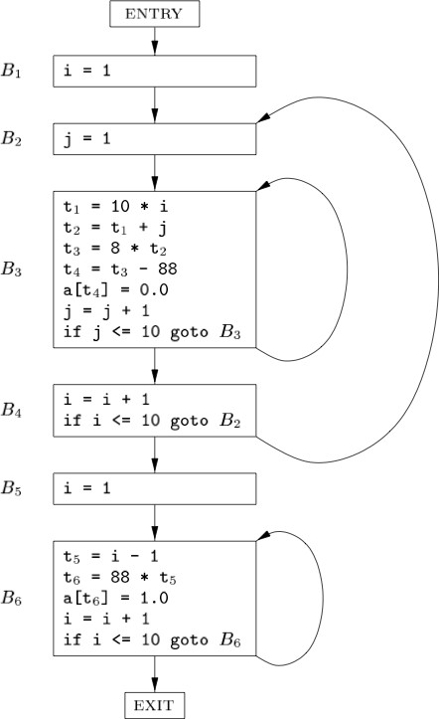
Basic Blocks and Flow Graphs
Code Generation

Slide 43
Flow graphs
Basic Blocks and Flow Graphs
Flow Graph is the the graph with basic blocks as nodes and branches as directed edges
Picture of basic blocks with arrows for possible control flows.
A loop is sequence of distinct basic blocks where
1
Entry to first block is loop entry is only label where control comes from basic blocks outside the sequence.
It is possible to reach the loop entry from any block in the sequence.
2
Code Generation

Slide 44
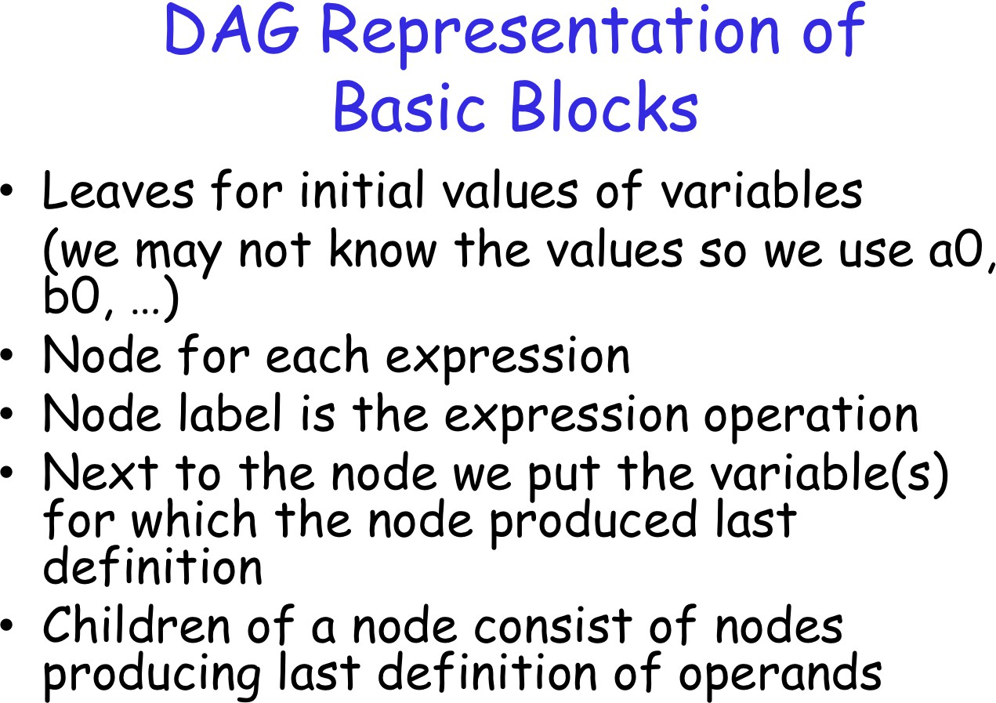
Basic Blocks and Flow Graphs
Code Generation

Slide 45
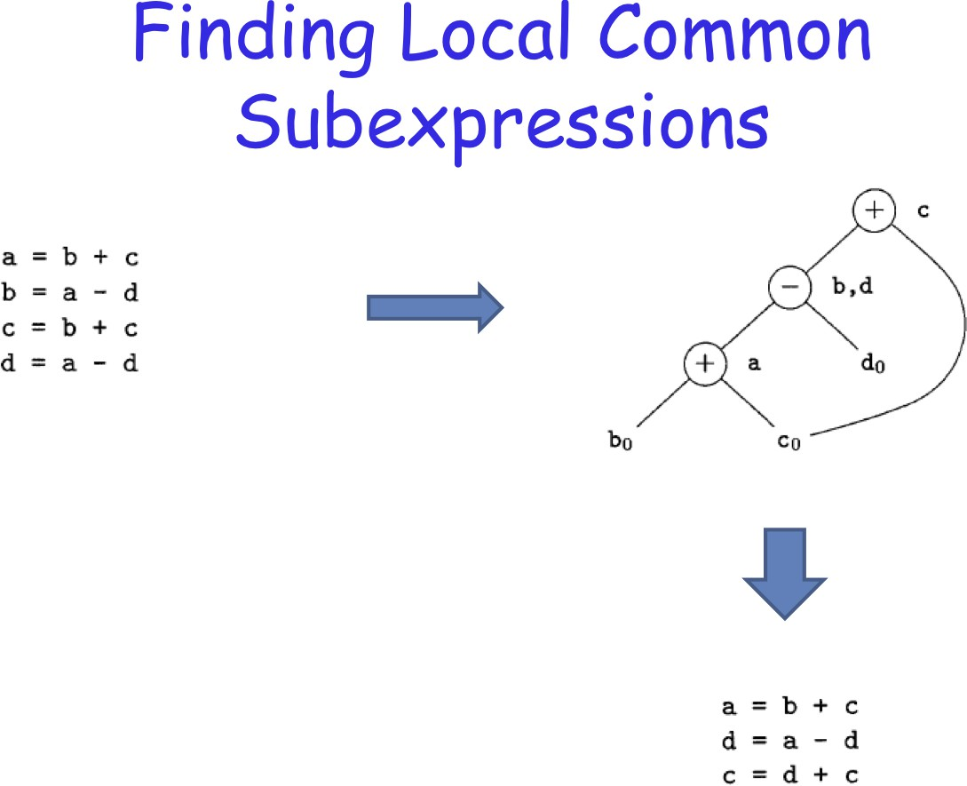
Basic Blocks and Flow Graphs
Code Generation

Slide 46
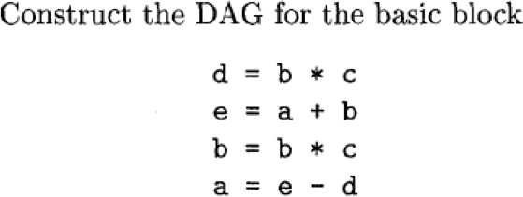
Basic Blocks and Flow Graphs
Code Generation

Slide 47
Dead Code Elimination
Basic Blocks and Flow Graphs
From the basic block DAG:
Remove any root node that has no live variables
Repeat until no nodes can be removed
Code Generation

Slide 48
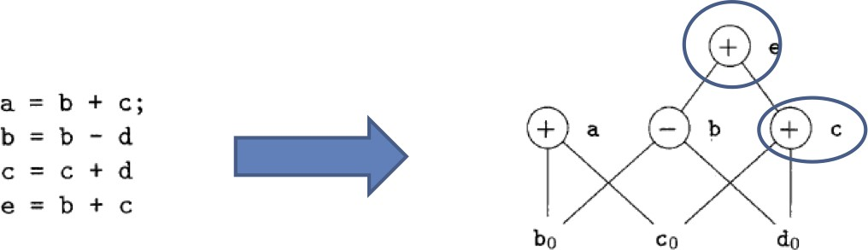
Basic Blocks and Flow Graphs
Code Generation

